Slide 1
Predicting Influencers in a Social Network
Group 11
Akshay Mehra
Sayam Ganguly
Patrick Green

Slide 2
Objective
Problem Definition
Predict the human judgement about which of two users is more influential in a social network, given twitter activity data for the pair.
Data Set
Numeric features for pairs of users (A and B). Both training and test data sets provided.
Follower/Following Count
Mentions Sent/Received
Retweets Sent/Received
Post Count
Listed Count (count of inclusion in user-created categories or lists)
Network Features (proprietary calculated features)

Slide 3
Approach
Pre-processing
Feature Selection – determine which features correlate with influence
Feature Transformations – normalize data
Modeling Methods
Logistic Regression
Neural Network
Support Vector Machines (SVM)
Ensemble
Evaluation
Measuring the area under the Receiver Operating Characteristic (ROC) curve, which plots true positives against false positives for probabilistic outcomes for a range of thresholds. (TODO – Add Sample Curve)
Baseline Solution:
The person who has more followers is the person who is more influential. (Area Under Curve : 0.75175)

Slide 4
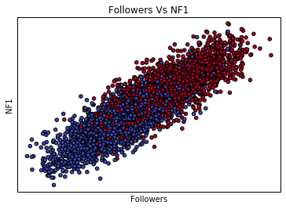
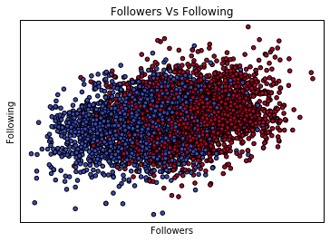
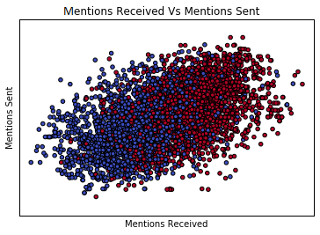
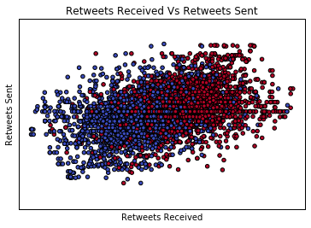
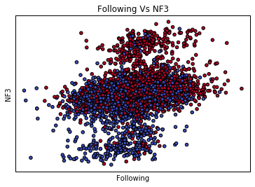
Data Visualization

Slide 5
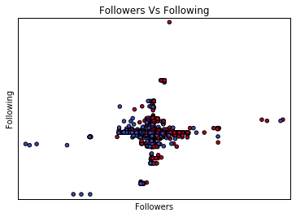
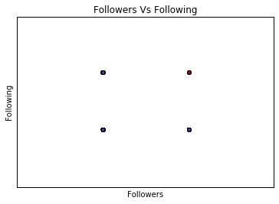
Feature Transformation
Delta Transform
Absolute difference between values for two users
Baseline
Preserves the meaning of large difference in values
To reduce the scale of the data, we normalize it.
Binary Transform
Reduce difference to one (larger for user A) or zero (larger for user B)
Simpler data set, but discards the magnitude of differences
Logarithm
Reduces large differences in the orders of magnitude in features (ie. follower versus following counts)
Simplifies non-linear relationships between input and output.

Slide 6
Feature Selection
Feature Selection (add Graphs)
Intuitive
PCA(Add Cumulative Curve)
K-Best(sayam)
Original Features(Matlab Sayam)

Slide 7
Models
Logistic Regression
Graphs on data transform
Graphs tweaking performance
Talk about Overfitting

Slide 8
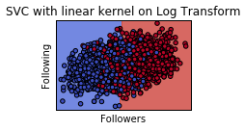
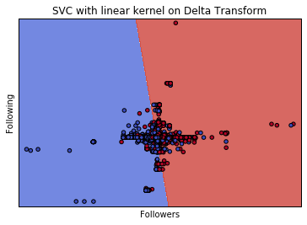
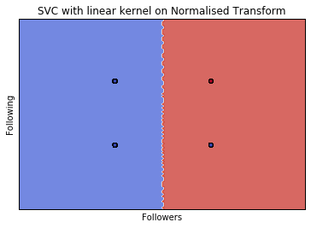
Models
SVM(Add ROC, change headers of the graph)
Graphs on data transform

Slide 9
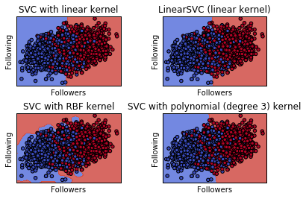
SVM(Add ROC)
Graphs tweaking performance
Talk about Overfitting

Slide 10
Models
NN
Graphs on data transform
Graphs tweaking performance
Talk about Overfitting

Slide 11
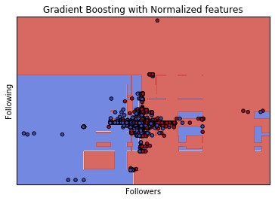
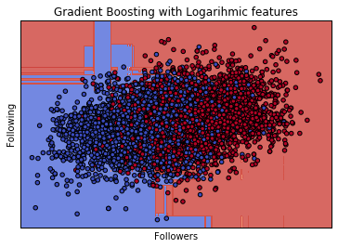
Models
Ensemble
Graphs on data transform
Graphs tweaking performance
Talk about Overfitting

Slide 12
Model Comparison
Compare Best Graphs with Accuracy (ROC)

Slide 13
Conclusion
Talk about what worked and what did not

Slide 14
Thanks!!

